Slide 1
Leavening Parish Council
Annual Meeting of the Council and the Annual Assembly of the Electors
18th May 2022

Slide 2
AGENDA
1. Election of the Chair
2. Election of the Vice-Chair
3. Declaration of Acceptance of Office
4. To receive apologies and reasons for absence
5. To receive any Declarations of Interest
6. Minutes from Monday 11 April meeting
7. Matters arising from the minutes of the previous meeting
8. Planning proposals for the Ryedale District
9. Applications for funding in relation to the Preston Hill Housing Development
10. Speeding in the village
11. Parish Council Communications: noticeboards, Facebook and website
12. Platinum Jubilee
13. Updates from local village groups/committee
14. Representatives for YLCA branch meetings
15. Questions to the Chair
16. Dates of future meetings

Slide 3
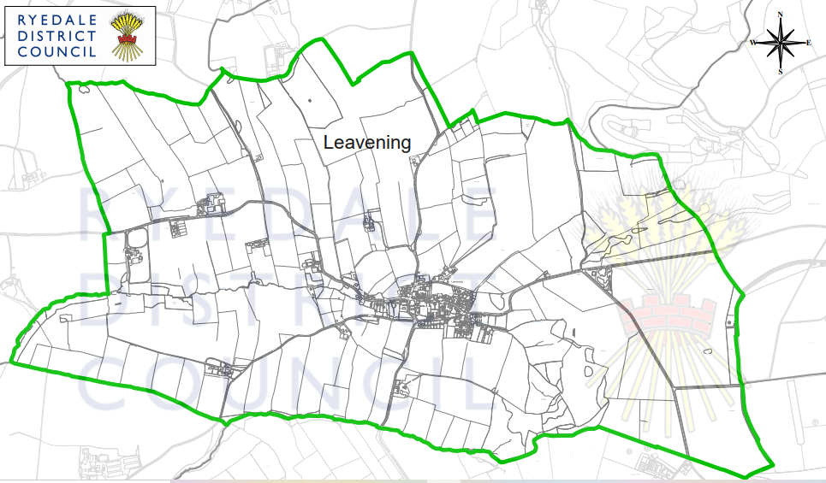
Ryedale Plan

Slide 4
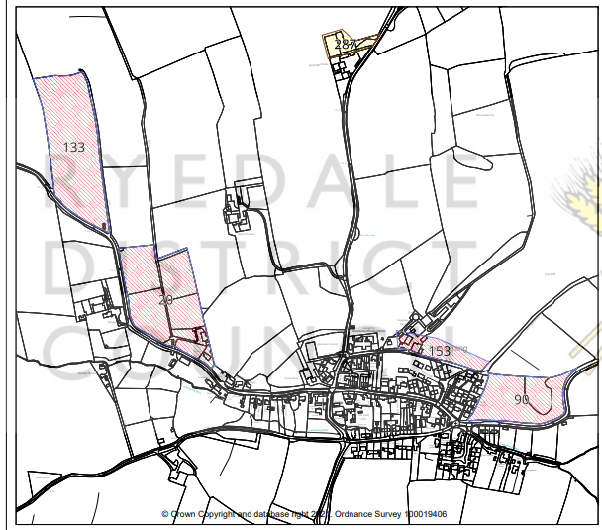
Submitted Sites
Site 20 – Oak Tree Stables, York Road, Leavening - residential
Site 90 – Land north of York Road, Leavening - residential
Site 133 – Land at Leavening, York Road – residential
Site 153 – Boundales Farm, Leavening – residential
Site 287 – Leavening Heights – mixed use

Slide 5
Timelines
Site assessment process is currently underway and is likely to inform decisions by planning team in September 2022
All residents asked to submit via the Ryedale Submitted Sites website
Parish Council will consider a response at the 11th July 2022 Meeting

Slide 6
Community Funding
Councillor Philip Schofield

Slide 7
Speeding in the Village: Review of findings
Councillor Sean McDermott

Slide 8
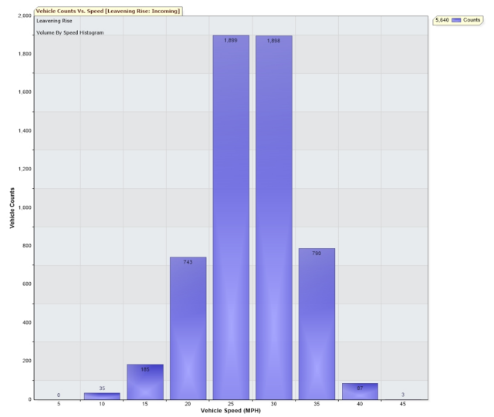
March 2022

Slide 9
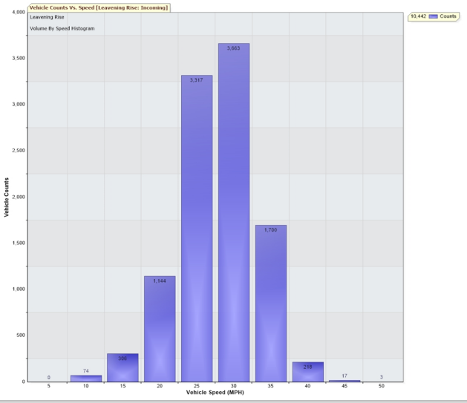
April 2022

Slide 10
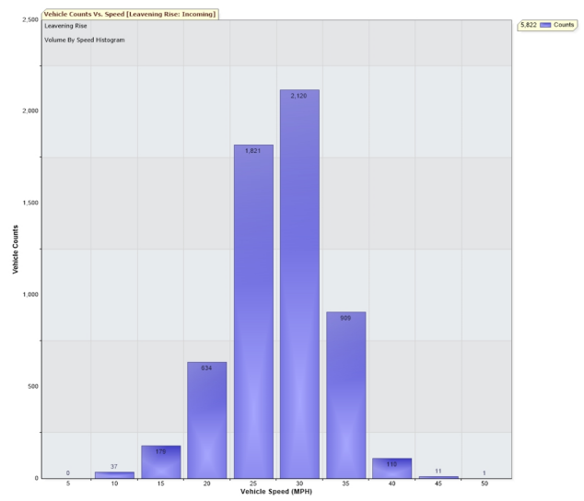
May 2022

Slide 11
20’s Plenty
Is speeding a problem for us?
Do residents want us to join the 20’s Plenty Campaign and lobby North Yorkshire to implement this across our village?

Slide 12
AGENDA ... continued
11. Parish Council Communications: noticeboards, Facebook and website
12. Platinum Jubilee
13. Updates from local village groups/committee
14. Representatives for YLCA branch meetings
15. Questions to the Chair
16. Dates of future meetings

